Slide 1

K-Nearest Neighbors

Slide 2
KNN Algorithm:
K-nearest neighbors (KNN) algorithm is a type of supervised ML algorithm which can be used for both classification as well as regression predictive problems.
It is simple , easy to learn, Lazy learning.
KNN is a lazy learning algorithm because it does not have a specialized training step and uses all the data for training while classification. Due to this prediction step is costly.
KNN algorithm assumes the similarity between the new data and available data and take the most similar data to the available data.

Slide 3
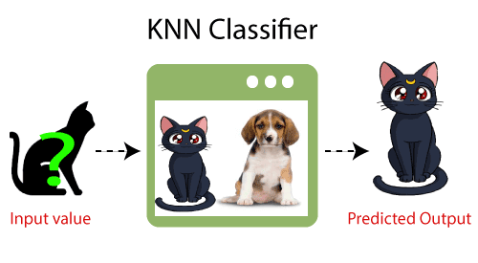
KNN algorithm at the training phase just stores the dataset and when it gets new data, then it classifies that data into a category that is much similar to the new data.
For example : Suppose, we have an image of a creature that looks similar to cat and dog, but we want to know either it is a cat or dog. So for this identification, we can use the KNN algorithm, as it works on a similarity measure. Our KNN model will find the similar features of the new data set to the cats and dogs images and based on the most similar features it will put it in either cat or dog category.

Slide 4
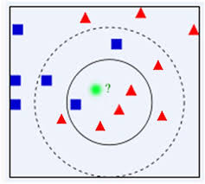
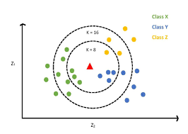

Slide 5
K in K- Nearest Neighbors:
K is the number we used to identify the similar neighbors for new data point.
KNN takes K to decide where the new data point with belongs to
The decision is based on the feature similarity.

Slide 6
How to choose the value of K:
There is no particular way to determine the value of K. so we need to try some values to find the best out of them.
On the value of k has impact on the results which we obtain from KNN algorithm.
A very low value for K such as K=1 , can be lead to give high error.
The most preferred value for K is 5, because at this test set reaches minimum error.
If the value of K is small then there is a probability of overfitting the model and if the K value is large then the model becomes expensive. So usually we choose odd number value for K .

Slide 7
Steps of KNN:
Step 1: select the value of K and it should be odd
Step 2: Calculate the Euclidean distance of new point to each of data point.
Step 3: Take the K nearest neighbors as per calculated distance from new point.
Step 4: Count the number of data points in each category among the K neighbor
Step 5: New data point will belongs to category for which number of neighbors are maximum for Classification.
For Regression, new data point will belongs to the average value of K neighbors.

Slide 8
How is the Distance Calculated?
It can be calculated by using :
Euclidean distance
Manhattan distance

Slide 9

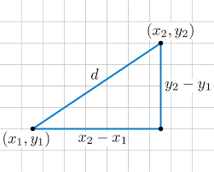
Euclidean Distance:
Euclidean Distance between (X1,Y1) and (X2,Y2) :

Slide 10
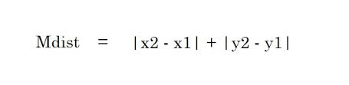
Manhattan Distance:
It is a sum of absolute values of the differences between two points.

Slide 11
Advantages of KNN:
It is simple to implement.
It can be more effective if the training data is large
Useful for classification and regression

Slide 12
Disadvantages of KNN:
The computation cost is high because of calculating the distance between the data points for all the training samples.
High memory required

